Slide 1

Non-Fungible Tokens:
New-age Profits?
Or Just a Gimmick.
CS4236 Group 9
Joshua Tan Yin Feng [A0199502Y],
Wu Yifan [A0242690E],
Foong Yan Kai, Brandon [A0135261N],
and Donavan Lim Jia Hui [A0206088A]
Source: Getty Images
Notes:
Hello everyone, welcome to our presentation on Non-Fungible tokens: New-age Profits? Or Just a Gimmick.

Slide 2
TABLE OF CONTENTS
01
02
03
INTRODUCTION
INSECURITIES WITH NFTs
MINT-IMPERSONATION SCHEME
04
05
LOTTERY SCHEME
CONCLUSION
Notes:
This is the flow of our presentation. We begin by introducing NFTs and their insecurities, propose 2 schemes to analyse NFT implementations, and conclude on the security of NFTs today.

Slide 3
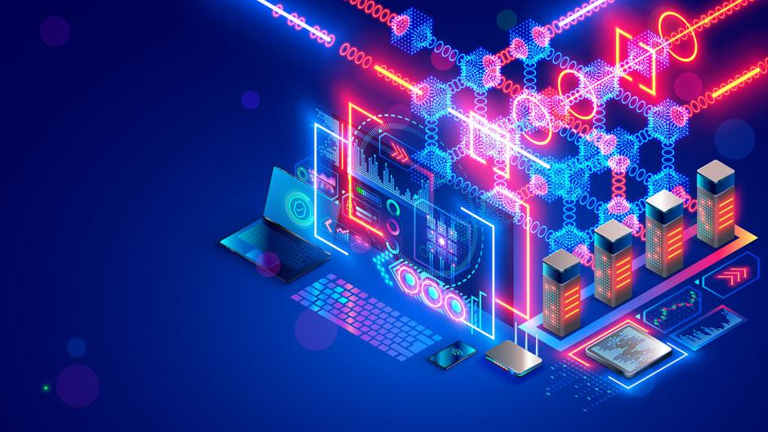
01
INTRODUCTION
Source: University of Miami
Notes:
First of all, what is NFT?

Slide 4
Non-Fungible Tokens (NFTs)
Core Properties
Unique & non-interchangeable
Blockchain + Smart Contracts
=> Certificates of authenticity; (instead of copyright conferment)
Verifiable ownership via private key of user’s digital wallet
Marketplaces
Source: Getty Images
Notes:
Non-fungible tokens, or NFTs, have seen a rise in popularity in recent times. They can be considered as a representation of ownership of a digital asset, and are therefore unique and cannot be interchanged with each other, unlike cryptocurrency. Based on the blockchain and smart contract, NFTs give a certificate of authenticity, or a license to use the artwork, instead of a conferment of copyright. NFTs enable verifiable ownership in the sense that the private key of the digital wallet is a proof of ownership of NFTs. Now the trading of NFTs in the field of digital art is fervid on third-party marketplaces such as OpenSea and Rarible.

Slide 5
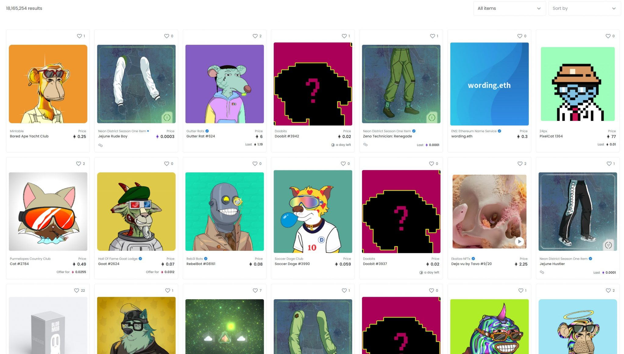

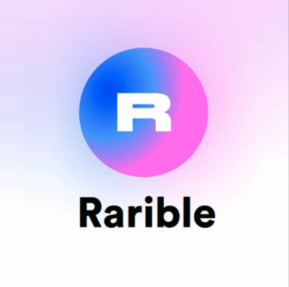
Fig 1. OpenSea’s marketplace dashboard showcasing NFTs for sale
Source: OpenSea, Rarible
Notes:
Here are some examples of NFTs for sale on Opensea

Slide 6


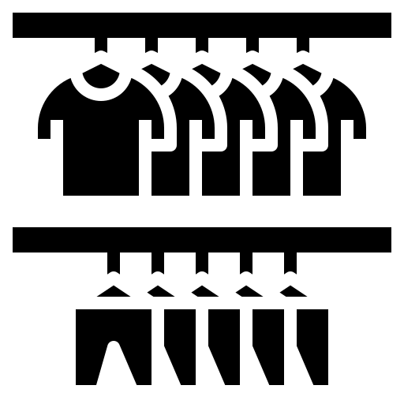

DIGITAL ART
TANGIBLE COLLECTIBLES
GAMING
Collections
Multiple editions
Merchandise
Apparel
Virtual Land
Collectibles
Metaverse
Source: Getty Images
Notes:
The aforementioned properties made NFT a great solution for trading in various industries, such as digital art, where buyers collect digital artworks and creators sell multiple licenses for their work. In games, NFTs can be applied in the trading of virtual land and collectibles on the metaverses. Merchandise trading in tangible collectibles can also take advantage of NFTs.

Slide 7
NFTs in 2021
Growth & Adoption
Industries
Gaming
Collectables
Virtual Land
Digital Art
Sports
Finance, De-Fi
Tangible Collectables
Q1 2021: $1.8 billion
Q3 2021: $10.7 billion
User-base:
Artists: Gain popularity and following
General: Wealth accumulation & protection
Source: One37PM
Notes:
In fact, NFTs can be widely adopted in most industries requiring commercial trade. As such, NFTs have experienced a meteoric rise in sales volume and attention. NFT-exchange skyrocketed from 1.8 billion USD in Q1 2021 to 10.7 billion USD in Q3. Adoption of NFT mainly comes from artists who wish to gain popularity and following, and general public hoping to accumulate and protect wealth.

Slide 8
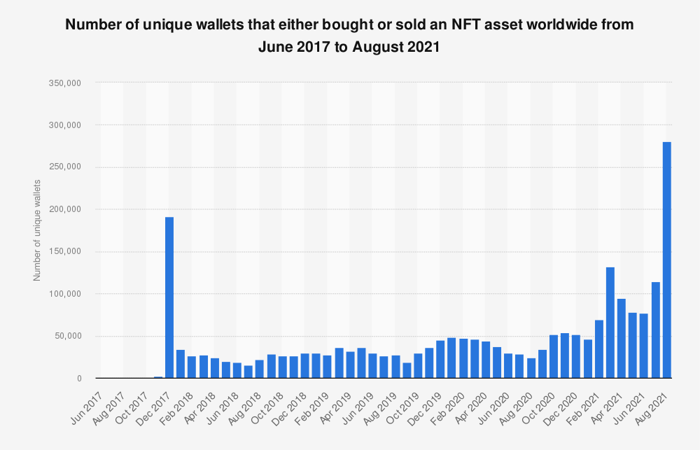
Fig 2. No. of Active Unique Wallets involved in (NFT-exchange)
Source: Statista, NonFungible.com
Notes:
Keeping in mind of the advantages, the number of active unique wallet involved in NFT trading has increased significantly since 2020.

Slide 9
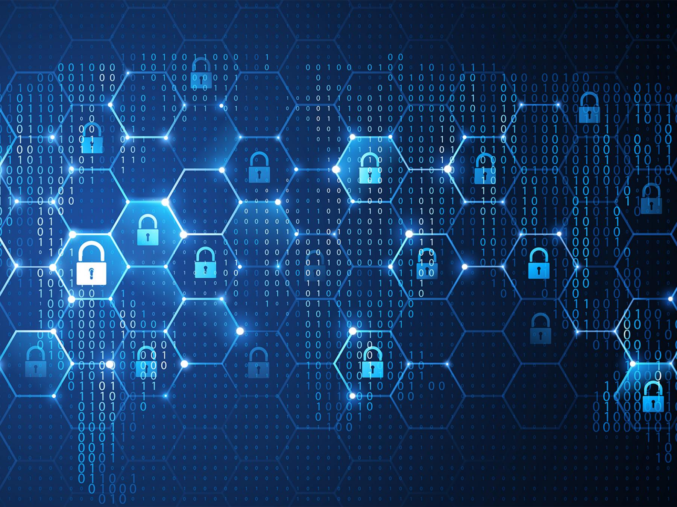
02
INSECURITIES
WITH NFTs
Source: Getty Images
Notes:
Thank you Lareina. Now, let us explore the insecurities and potential dangers in using NFTs.

Slide 10
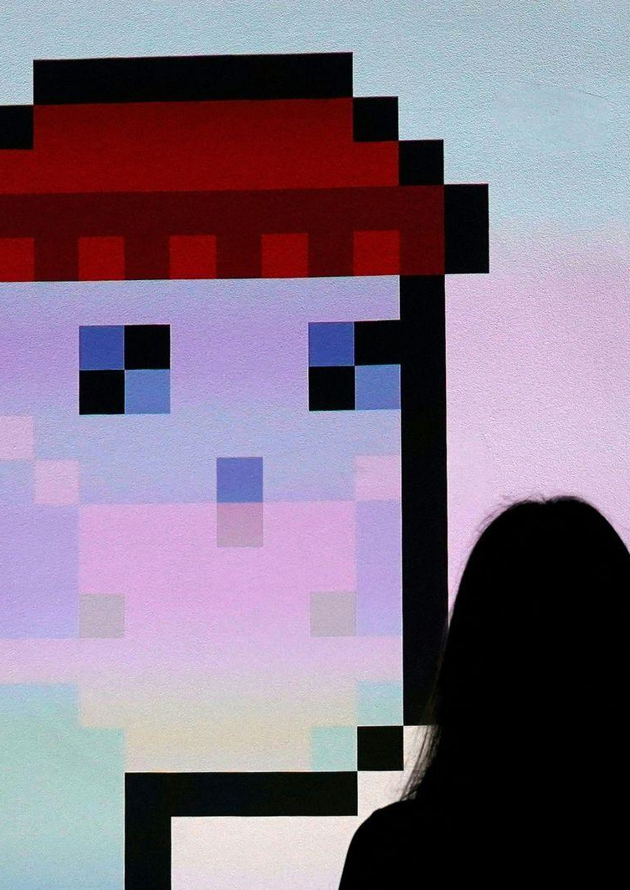
BUILT UPON EXISTING SECURITY TECHNOLOGIES
Reliant on the security of multiple technologies: blockchain, smart contract etc.
Takes only 1 vulnerability to exploit NFTs
Source: Getty Images
Notes:
NFTs are not a standalone technology. Instead, they are built upon multiple technologies such as the blockchain, smart contracts, the internet, and are reliant on them
Which means that if one technology presents a security vulnerability => NFTs can be compromised with that exploit.

Slide 11
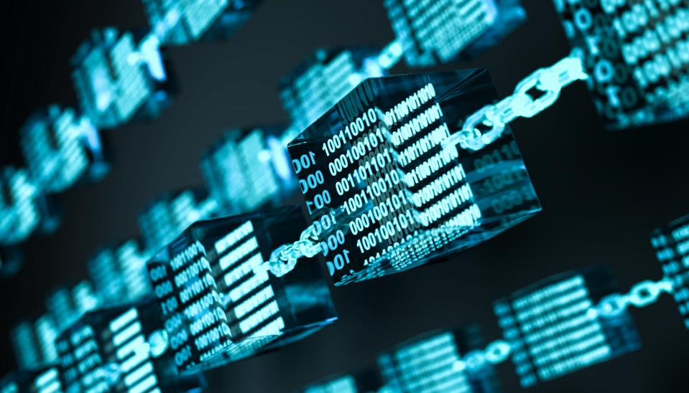
03
MINT-IMPERSONATION SCHEME
Source: Getty Images
Notes:
There is 1 infamous attack whose mechanism is worth exploring, and we call the mechanism used the mint-impersonation scheme.

Slide 12
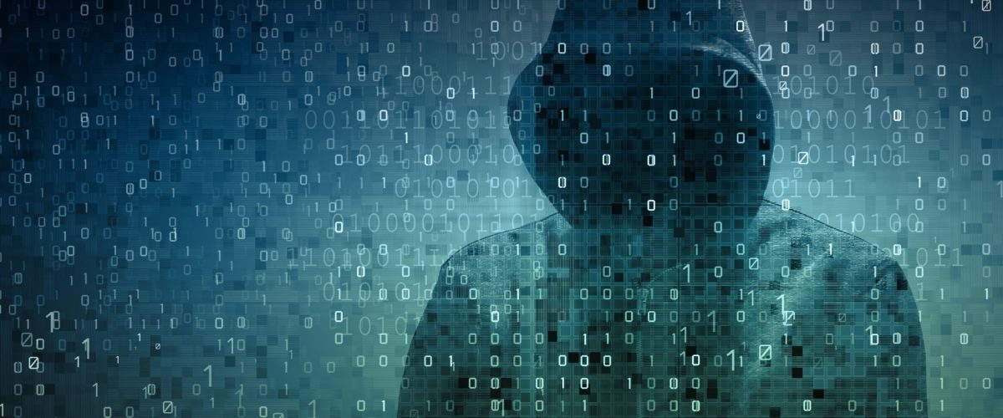
MINT-IMPERSONATION
CONTEXT
Source: Getty Images
Minting: to establish ownership of an NFT to an owner on the blockchain
Sleepminting:
Mint an NFT under a reputable artists’ name
Put up NFT for sale
Divert profits from artist’s to own account
Notes:
Minting is when an NFT with an established ownership becomes a part of a blockchain.
Similar to how metal coins are minted and added into circulation.
Sleepminting occurs when NFTs for digital assets under an
artist’s name are minted without their consent and then sold on the marketplace.
The profits are pocketed into the accounts of the fraudster who minted without the artist’s consent.

Slide 13
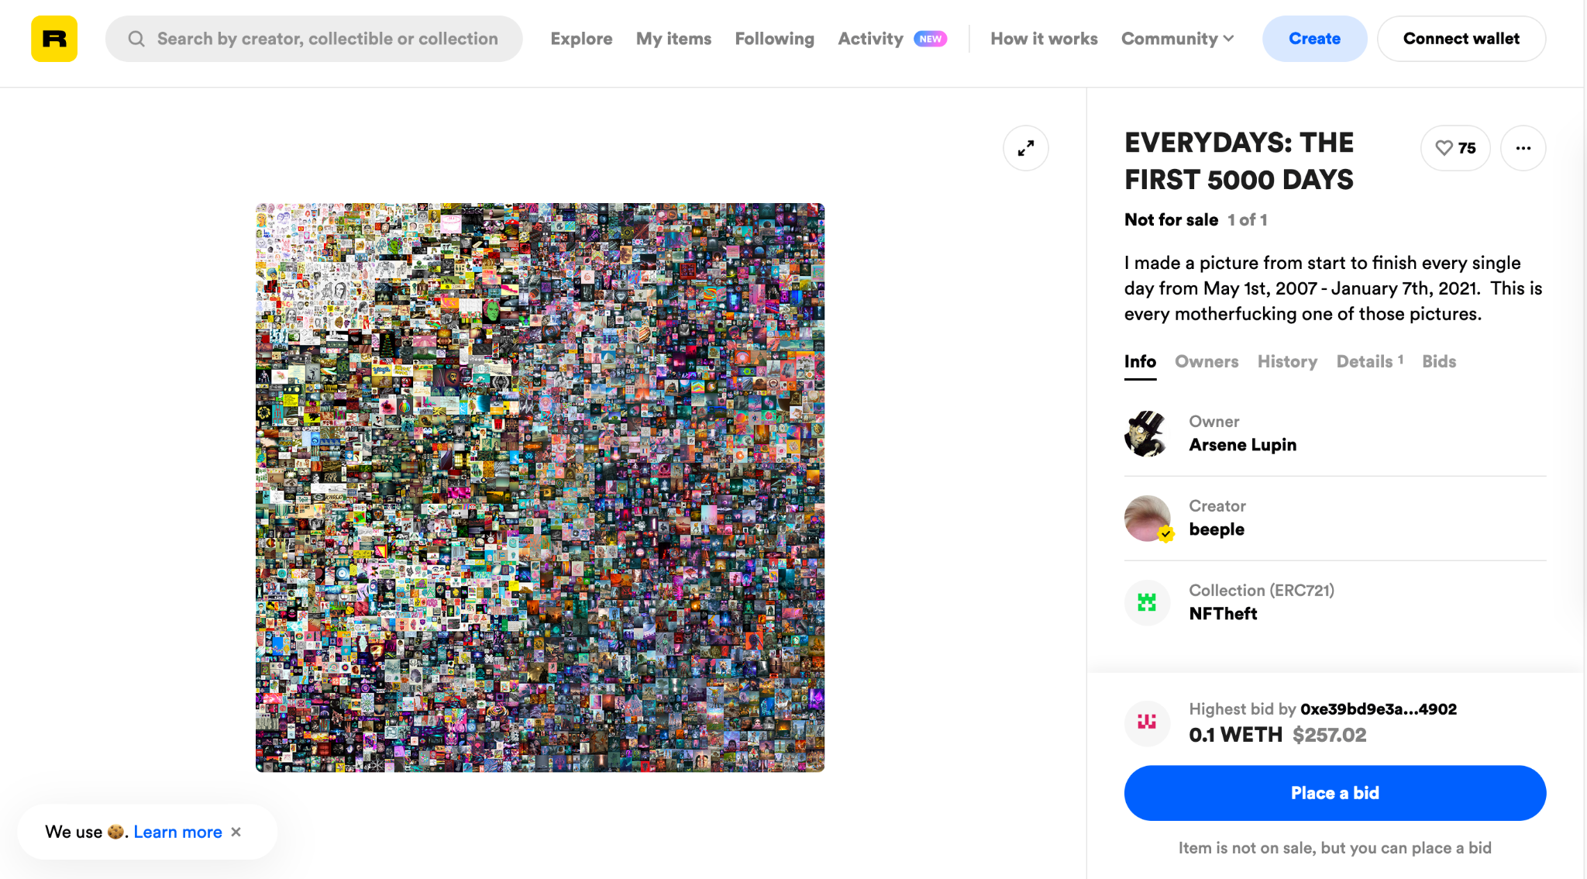
Fig 3. An infamous example of a sleepminted NFT on Rarible, that looks legitimate
Source: timdaub.github.io
Notes:
An infamous example of sleepminting
was the fake digital art NFT sleepminted under the reputable account beeple on rarible, which transacted for 69 million dollars.
The buyer was tricked to believe that beeple had minted this piece.

Slide 14
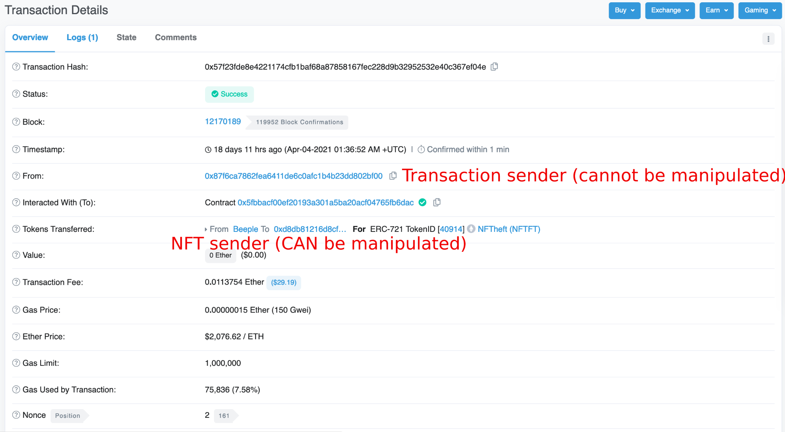
Fig 4. A successful sleepmint where the sender’s address had been tampered with
Source: Etherscan, timdaub.github.io
Notes:
This is Etherscan, showing the transaction of a sleepmint.
The first ‘From:’ field reveals a hash of the seller’s address, which is unforgeable.
The second “From:” under the Token Transferred field however can be forged to beeple.
The transaction of the NFT had been legitimately written in the blockchain. Blockchains are proven to be secure and we can rule out the blockchain ledger as a cause of this.
Rather, it is that the mismatch between the hash and the sender name was not detected by Rarible.
So, how is this possible?

Slide 15
ERC721 SMART CONTRACT STANDARD
ERC721 Interface
Fraudulent mints
Does not stipulate NFT-minting implementation
Marketplace service-providers implement their own
A backdoor for sleepminting
A set of functions for implementing NFTs
Designed for non-fungibility
Smart contracts, wallet, metadata
Source: Ethereum.org
Notes:
NFTs are implemented via smart contracts.
A standard known as ERC721 form an interface of functions that NFT smart contracts must have pertaining to tracking and transacting non-fungible tokens, with functions for wallet and metadata
(click)
ERC721 however does not specify a secure implementation of minting NFTs.
Marketplaces such as OpenSea and Rarible are left to implement and modify systems to enable NFT transactions following ERC721,
which may open a backdoor for sleepminting.
This underscores the relevance of understanding the minting process of an NFT.
I will handover to Brandon to expound more on a scheme where an adversary impersonating another user and minting an NFT under the victim’s account

Slide 16
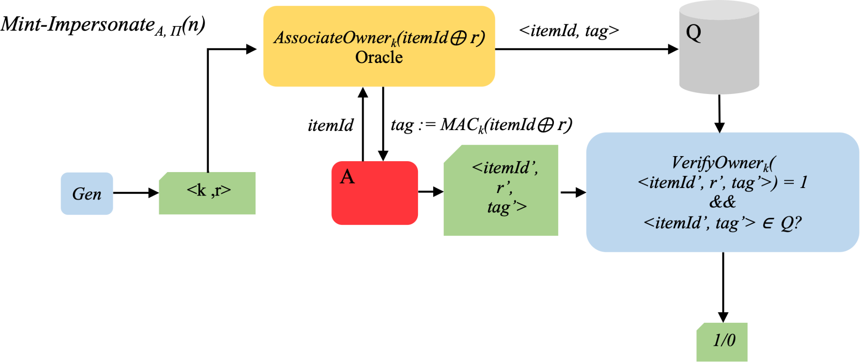
MINT-IMPERSONATE SCHEME
Mint definition
Gen(1^{n}):
output key k and random value r
AssociateOwner(k, itemId, r): output tag
VerifyOwner(k, itemId, r, tag): output 1 if valid and 0 otherwise
Key k & random value r: generated by Gen
Adversary A has multiple access to oracle AssociateOwner
Given any itemId, return tag
Store each query in set Q
A outputs <itemId’, r’, tag’>
A succeed if and only if
VerifyOwner(itemId’, r’, tag’)=1
<itemId’, tag’>∊Q
Notes:
Let’s take a look at how we can use the appropriate cryptographic primitives to prevent this issue. First, we define a mint in 3 steps: Gen generates a key and random value. AssociateOwner takes the key, random value and itemId, and outputs a tag to symbolize ownership. Finally, VerifyOwner can be called on the key, random value, item ID and tag, and verifies that tag corresponds to the other three value.
Then, we formalize this system in terms of an adversarial model. In this scheme, we first generate a key and random value pair, which is passed to the oracle. Next, the adversary is allowed access to a AssociateOwner oracle, and can query itemID to get a valid tag for that item, which represents how an individual can see item ID and tag pairs which are minted onto the blockchain. The goals of the adversary is to generate a valid itemId, key, random value and tag tuple of an item that has already been queried before. This is similar to how they can try to impersonate ownership of an object that has already been minted on the blockchain.

Slide 17
Not Impersonate-able
Definition
Construction
Our scheme is not impersonate-able if and only if for any probabilistic polynomial time adversary, there exists a function negl such that:
Pr[Mint-Impersonate(n)=1] ≤ negl(n)
𝚷’=(Gen, Mac, Vrfy): secure MAC scheme
Gen: On input 1^{n}, output key k and random value r
AssociateOwner: On input (itemId, r), output tag:=Mac(itemId⊕r)
VerifyOwner: On input (itemId, r, tag), output Vrfy(itemId⊕r, tag)
If 𝚷’ is a secure MAC, then the construction is not impersonate-able
Notes:
Here is our construction of a non-impersonatable scheme. It is built upon message authentication codes, and we claim that if the construction pi prime is a secure mac, then the construction is not impersonatable

Slide 18
PROOF SKETCH OF NON-IMPERSONATABILITY
Two Cases: r’ = r and r’ ≠ r
Case 1: r’ = r
If the adversary can retrieve the value of r used, he can win with probability 1
However, this is negligible (2^{-n}), due to the randomness of r
Case 2: r’ ≠ r
If the adversary can find a new r’ that wins in the impersonation scheme, then this can be used to win the underlying MAC scheme
Hence, it is also bounded by a negligible function
In both cases, the probability of winning is negligible, hence the total probability is also negligible
Notes:
Finally, here is a short proof sketch of why our proposed construction works. Here, we split it into two possible cases, one where the adversary can retrieve the random value r and outputs r’ equals r, and one where the adversary outputs a r’ that is not equal to r. If the adversary can retrieve r, he can win the mint-impersonation game with probability 1. However, by the randomness of r, the probability of this occurring is a negligible.
In the other case, if the adversary can output a new r’ that wins the mint-impersonation game. If we look at the construction in the previous slide, we can see that itemID xor r’ and tag is a valid pair that has not been queried before, hence this adversary can also be used to construct a new adversary that can win the Mac-forge experiment. Thus, the probability of winning in this case is bounded by a negligible function.
In either case, the probability of winning is negl, hence the total probability is negligible.
Next, Joshua will talk about the concept of fairness in lootboxes and lotteries implemented via NFTs.

Slide 19
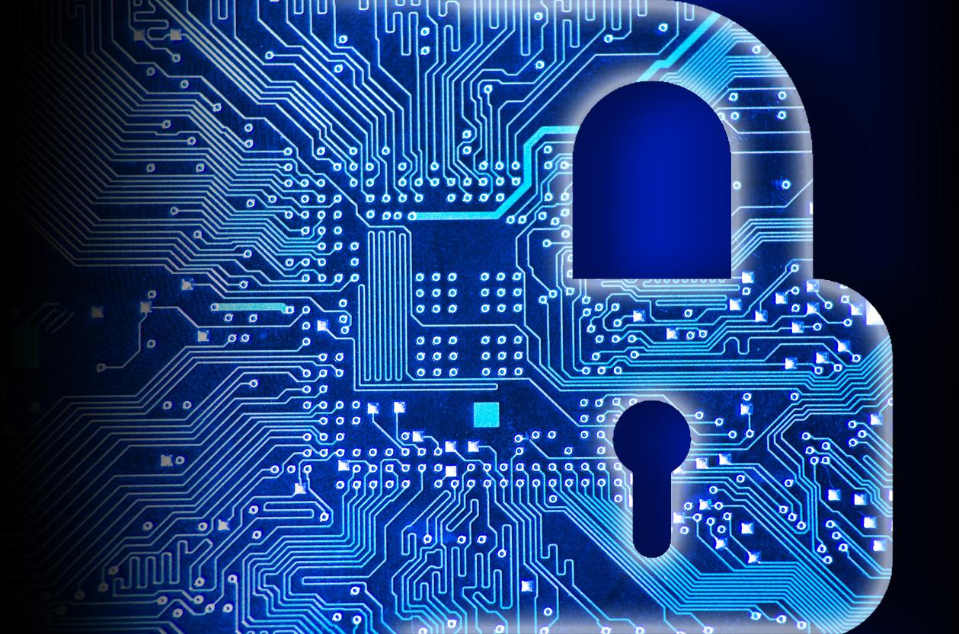
04
LOTTERY SCHEME
Source: Getty Images
Notes:
Thank you brandon.

Slide 20
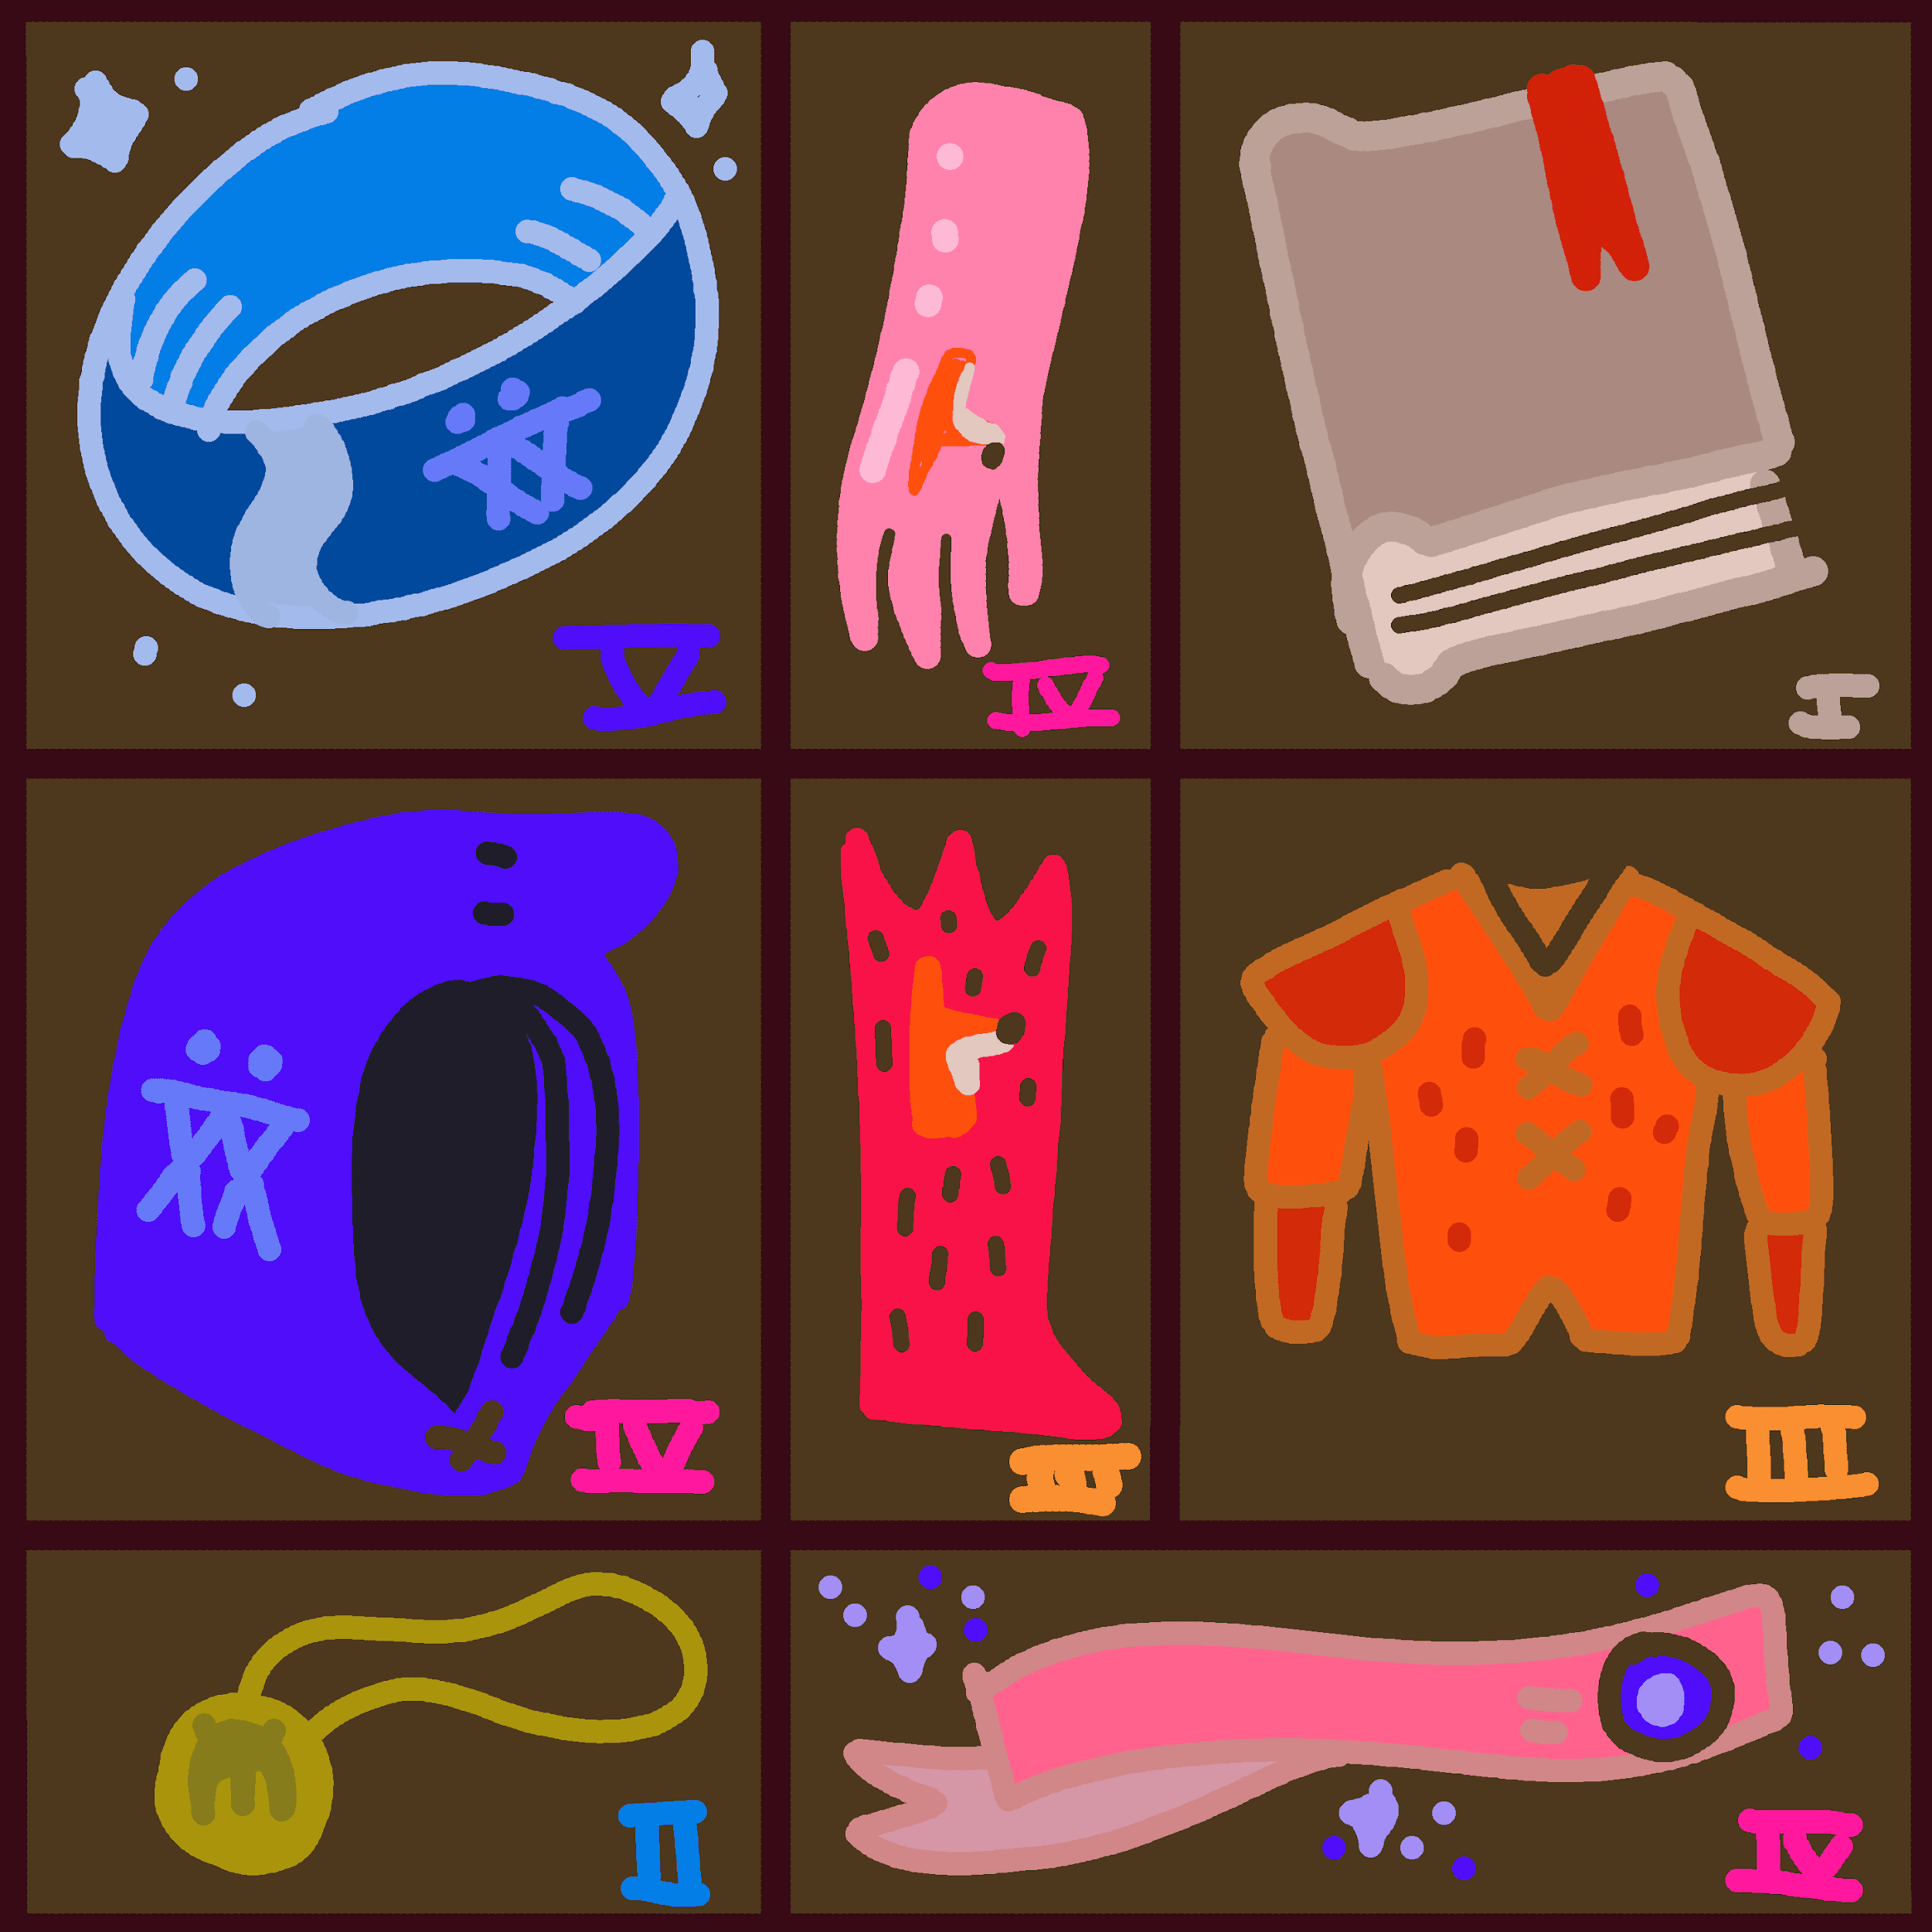
LOOT PROJECT
Source: Twitter
Giveaway system
8,000 NFTs for free
Each loot bag contains items of varying rarity
To mint a bag, choose a random bag id from 1–8000 and try to mint
Giveaways are popular and generate a lot of attention
Notes:
On 28 Aug 2021, an NFT giveaway called Loot Project
8000 NFTs known as loot bags were available to mint for free
Each loot bag contains an item of varying rarity. Items are similar to what you will find in a game like Dungeons and Dragons
The minting process only involves choosing a random bag id from 1-8000 and trying to mint it
This giveaway garnered a lot of attention and has shown to be a great way to start growing a fanbase for any NFT project

Slide 21
Similarities with a Lottery System
1
2
3
...
8000
8000 numbers with predetermined prizes
Randomly pick one number and hope that it’s a winning number
Ideal:
Every number picked has the same odds of winning
Notes:
One can see that such a giveaway system is very similar to a lottery system with a set of numbers and a predetermined set of prizes
A participant randomly picks a number and hopes that its a winning number
In an ideal scenario, every number that is picked should have the same odds of winning
This is a very important security requirement as we do not want any number to be more favourable than others. If any participant learns of such a number, then the lottery would be very unfair!

Slide 22
INSPIRATION BEHIND OUR LOTTERY SCHEME
Lottery Numbers
1
2
3
...
8000
Lottery Prizes
Lose
Win
Lose
...
Lose
Bit string indices
0
1
2
...
7999
Bit string
0
1
0
...
0
Notes:
And so we turn to defining a lottery scheme and to construct a security property known as fairness
Our inspiration comes from the fact that we could model a lottery after a bit string. Each index of the bit string can represent a lottery number and the bit at that index can indicate whether or not it’s a winning or losing number!

Slide 23
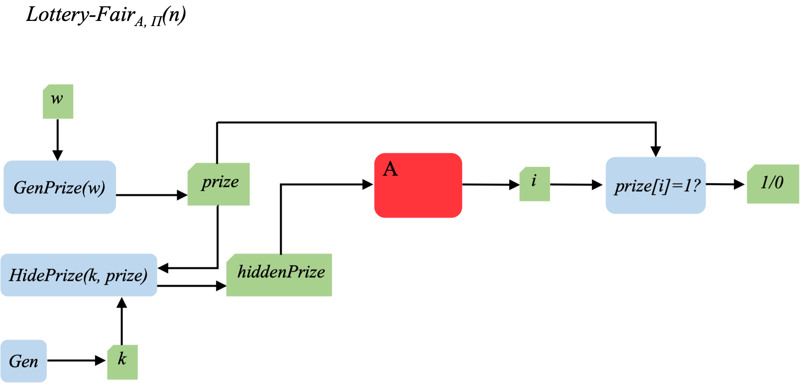
LOTTERY SCHEME
Lottery definition
Gen(1^{n}): output key k
GenPrize(w): output string prize such that the fraction of 1s equals w
HidePrize(k, prize): output hidden-prize string hiddenPrize
Key k: generated by Gen
prize, hiddenPrize: generated by GenPrize(w) & HidePrize(k, prize)
Adversary A is given hiddenPrize
A outputs i that represents the i^{th} bit in prize
A succeed if and only if i^{th} bit in prize is 1
Notes:
More formally, our lottery scheme consists of 3 algorithms that would:
First, generate a string prize such that the fraction of 1s it has is equal to w
And secondly, produce a string hiddenPrize that is a masked version of prize. This is necessary as we we want to hide the information about prize.
(click next)
Our Lottery game would simply involve running these algorithms and giving the string hiddenPrize to an efficient adversary. The job of the adversary would be to guess which bit in prize is equal to 1. As mentioned previously, this is analogous to a lottery participant guessing which lottery number is the winning number!

Slide 24
Fairness
Definition
Construction
A lottery is fair if and only if for any probabilistic polynomial time adversary, there exists a negligible function negl such that:
Pr[Lottery-Fair(n,w)=1] ≤ w + negl(n)
Gen: On input 1^{n}, output key k
GenPrize: On input w, output string prize
VerifyOwner: On input (k, prize), output hiddenPrize=G(k)⊕prize, where G is a PRG
If G is PRG, then the construction is fair
Notes:
A lottery is then deemed as fair if the adversary only has a negligible probability greater than the winning probability of guessing the ith bit of prize.
This property of fairness is very similar to that of the indistinguishable property in a one time pad encryption scheme. Indistinguishability in the one time pad encryption scheme implies that any efficient adversary cannot do better than randomly guessing the ith bit in the plaintext.
Borrowing on this idea, our lottery scheme construction involves using a pseudorandom generator G that would help to pad against the string prize to generate hiddenPrize.
We claim that if G is a secure PRG, then the construction is fair

Slide 25
Lottery-Fair
Proof Sketch of a Fair Lottery Construction
Intuition behind proof
Construct a distinguisher D that emulates the Lottery construction for A
Ability of A to succeed in its Lottery game is related to the ability of D to succeed in its Distinguishing game
If A succeeds with non-negligible probability, then D succeeds with non-negligible probability
Since G is a secure PRG, then D can never succeed with non-negligible probability. This implies that A can never succeed with non-negligible probability as well.
If A can guess the i^{th} bit of prize with non-negligible probability more than the winning probability, then it is also able to implicitly distinguish between a truly random string and a pseudorandom string.
Notes:
The intuition of our proof is that if A can guess the winning bits with non-negligible probability more than the winning probability, then it implies that it can distinguish between a truly random string and a pseudorandom string
Our proof is similar to the proof provided in the textbook on the how a PRG provides security against an eavesdropper encryption scheme.
Specifically, we construct a distinguisher D that emulates the lottery construction for A while playing its own distinguishing game
Ability of A to succeed in its Lottery game is related to the ability of D to succeed in its Distinguishing game

Slide 26
Lottery-Fair
Distinguishing Game for D with A as a subroutine
D is given a string s that is either truly random or generated from G(k).
In either case, D’s probability of winning its distinguishing game is equal to A’s probability of winning in its fair lottery game when ran as a subroutine of D
Notes:
In the distinguishing game, D is given a string s that is either truly random or generated from the PRG
The 2 equations on the screen show the probabilities of winning the distinguishing game for either cases.
With the assumption that G is a secure PRG, then combining both equations completes the proof that our construction is fair

Slide 27
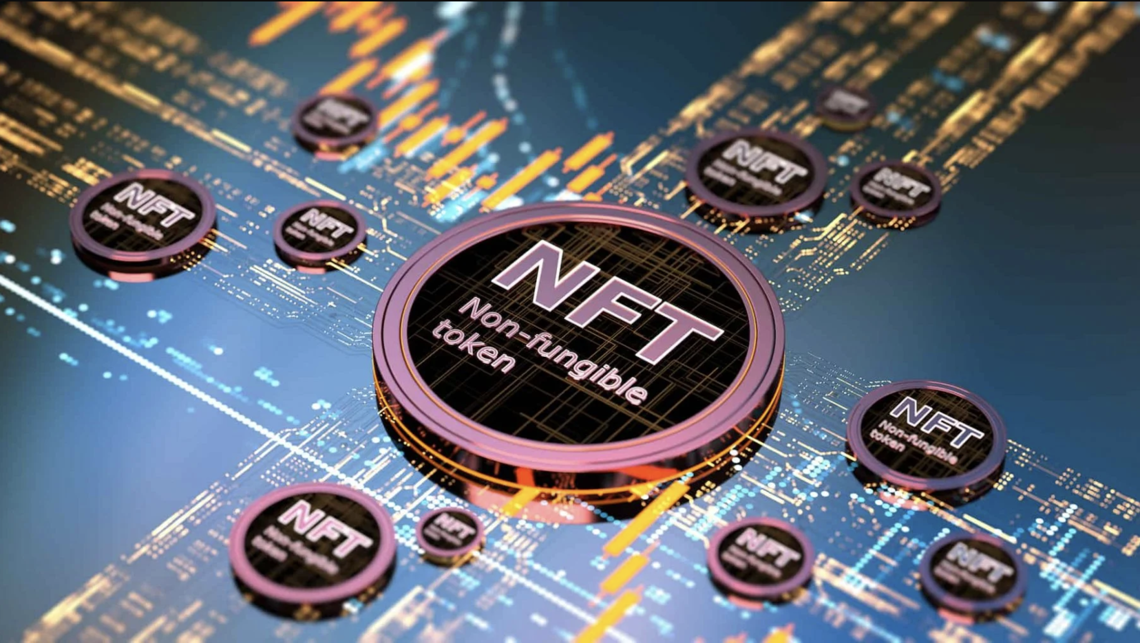
05
CONCLUSION
Source: Getty Images

Slide 28
SUMMARY
MINT-IMPERSONATION
NFT ADOPTION
Impersonate-able
CASE STUDIES
LOTTERY
Fairness
Mainstream, ubiquitous
Attacks have magnified consequences.
Cryptanalysis reveals qualities => areas of improvement for NFT-implm. to
minimise risk of attacks
Notes:
NFTs have been hailed as a salient tool for wealth accumulation in the new age.
It is a matter of time before the adoption of NFTs becomes mainstream.
Attacks will have extensive consequence on a growing body of users.
We studied how sleepminting attacks and Loot boxes are incidents where NFT-based systems have been compromised.
So having formalised the impersonation scheme / lottery scheme, we analysed how appropriate qualities of Impersonatable and Fairness can assess implementations, reveal areas of improvement, and reduce risks.
In conclusion, it is increasingly vital and relevant that the security and NFT communities continue to investigate security qualities that make up NFT implementations in order to protect the wellbeing of numerous NFT users, which may include us in the future.

Slide 29
THE END
Notes:
Thank you.

Slide 30
REFERENCES
DCL Blogger. Updated: April 2, 2021.. 20 industries disrupted by nfts. ONE37pm. Retrieved November 4, 2021, from https://www.one37pm.com/nft/tech/industries-impacted-by-nfts-art-music.
Daubenschütz, T. (2021, April 22). What is sleepminting and will it ruin NFT provenance? Tim's website. Retrieved November 4, 2021, from https://timdaub.github.io/2021/04/22/nft-sleepminting-beeple-provenance/.
Entriken W. (@fulldecent), D. S. (2018, January 24). EIP-721: Non-Fungible token standard. Ethereum Improvement Proposals. Retrieved November 3, 2021, from https://eips.ethereum.org/EIPS/eip-721.
NonFungible.com. 2021. Market history: NFT sales and Trends.. Statista. Retrieved November 4, 2021, from https://nonfungible.com/market/history.
Resources:
Getty Images, iStock, Flaticon

Slide 31
ACKNOWLEDGEMENT
We would like to thank our Course Coordinator, Professor Hugh Anderson, for conducting CS4236 Cryptography Theory & Practice.
From CS4236 Group 9
Joshua Tan Yin Feng [A0199502Y],
Wu Yifan [A0242690E],
Foong Yan Kai, Brandon [A0135261N],
& Donavan Lim Jia Hui [A0206088A]

